Slide 1
Mathematics for Computer Science - III CS203
Probability
Lecture 1

Slide 2
Aim of the course
To equip the students with tools of probability theory from perspective of computer science.
To cover necessary background of probability theory for courses like Machine Learning, Randomized Complexity, Randomized algorithms.
Bigger aim: To make sure every student gets a glimpse of the beautiful world of probability theory so that he/she becomes a fan of probability theory.

Slide 3
A paradox
Chord and an equilateral triangle

Slide 4
Chord and an equilateral triangle
C
A chord is picked randomly.
What is the probability that its length is more than the length of AB in the triangle?
A
B

Slide 5
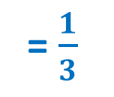
Answer 1
= $\frac{1}{3}$
C
A
A
B
Fact 1:
Length of a chord is uniquely defined by its two endpoints.
Pick the endpoints of the chord randomly

Slide 6
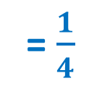
Answer 2
= $\frac{1}{4}$
C
A
A
B
Fact 2:
Length of a chord is uniquely defined if we know the center of the chord.
Pick the center of the chord randomly.

Slide 7
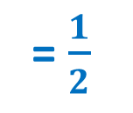
Answer 3
= $\frac{1}{2}$
C
Which answer is correct ?
A
A
B
Fact 3:
Length of a chord is uniquely defined if we know its distance from the center of circle.
Pick the distance of the chord from center randomly

Slide 8
A problem from JEE days
3-dices

Slide 9
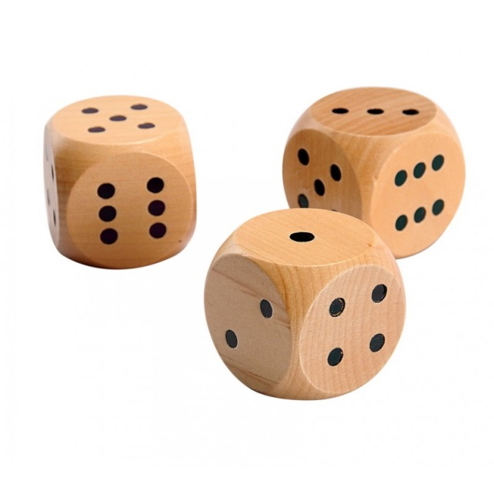


3-dices
Step 1: 3 dices are thrown.
Step 2: 3 dices are thrown again.
Question: What is the probability that both outcomes are identical
If the dices are distinguishable.
If the dices are in-distinguishable.
$$\frac{1}{216}$$
$$\frac{83}{3888}$$

Slide 10
A New Problem
Letters and envelopes

Slide 11



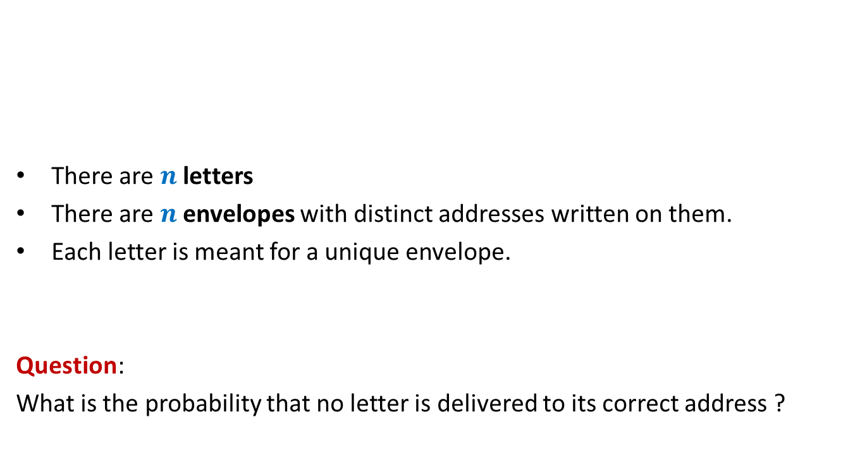




Letters and envelopes
$$\frac{1}{2}$$
There are $n$ letters
There are $n$envelopes with distinct addresses written on them.
Each letter is meant for a unique envelope.
Question:
What is the probability that no letter is delivered to its correct address ?
$n$ = $2$
$n$ = $3$
$$\frac{1}{3}$$
$n$ = $4$
$$\frac{3}{8}$$
Letters are assigned randomly uniformly to the envelopes, one by one.
Homework: Try to find solution for a generic $n$.

Slide 12
A Conditional probability Problem
5-Coins

Slide 13




5-Coins
Ponder over these questions and answers with fresh mind ☺.
2 normal coins
2 coins with HEAD on both sides
1 coins with TAIL on both sides
A coin is picked randomly uniformly
The coin is tossed.
$$\frac{3}{5}$$
Question:
What is probability that outcome of toss is HEAD ?
The outcome is
The same coin is tossed again.
$$\frac{5}{6}$$
Question:
What is probability that outcome of toss is HEAD ?
The outcome is
The same coin is tossed again.
$$\frac{9}{10}$$
Question:
What is probability that outcome of toss is HEAD ?

Slide 14
A surprising Problem
Area of shadow

Slide 15
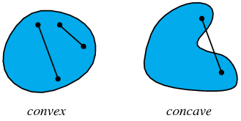
A convex body
Definition:
A 3-D body is said to be convex if for each pair of points on the body,
all the points lying on the line joining them also lie inside the body.

Slide 16



A convex body
Definition:
A 3-D body is said to be convex if for each pair of points on the body,
all the points lying on the line joining them also lie inside the body.
Does it hold true for any convex body as well ?
Sphere surface area : $4πr^{2}$
Ratio = $1/4$
yes
Shadow surface area : $πr^{2}$

Slide 17
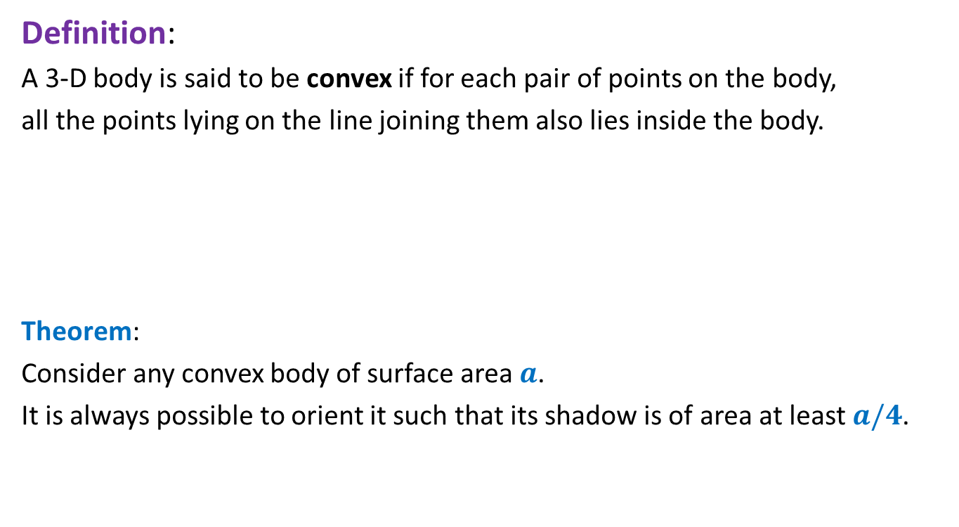
A convex body
Definition:
A 3-D body is said to be convex if for each pair of points on the body,
all the points lying on the line joining them also lies inside the body.
Theorem:
Consider any convex body of surface area $a$.
It is always possible to orient it such that its shadow is of area at least $a/4$.
Does this theorem have anything to do with probability theory ?
Proof: based on elementary probability theory.

Slide 18
Recruitment Problem
Google USA visits IITK for recruitment …

Slide 19
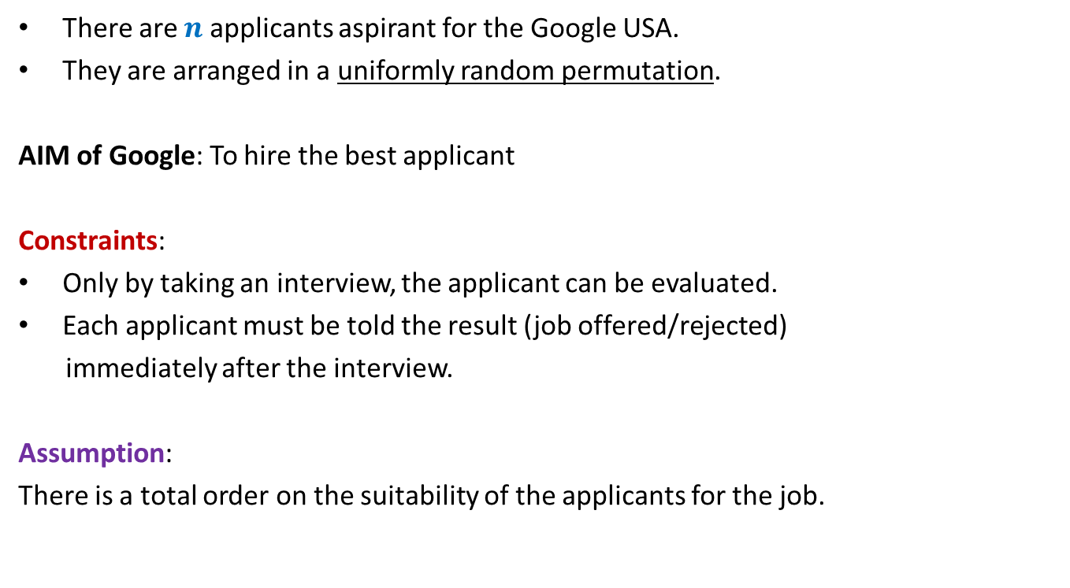
There are $n$ applicants aspirant for the Google USA.
They are arranged in a uniformly random permutation.
AIM of Google: To hire the best applicant
Constraints:
Only by taking an interview, the applicant can be evaluated.
Each applicant must be told the result (job offered/rejected)
immediately after the interview.
Assumption:
There is a total order on the suitability of the applicants for the job.
Design a strategy for the recruitment.

